Slide 1
Task -1
Develop IaC Scripts for Networking Components (VPC, Subnets)

Slide 2
What is AWS VPC?
AWS VPC is a service that helps users create a virtual network on the AWS cloud platform.
In the VPC, users can create their own public or private subnets, routing tables, internet gateways, and NAT gateways.
Users can create a security group associated with a VPC for better security, here users define inbound and outbound rules.
NACLs are used at the subnet level to allow or deny particular IPs when trying to access the subnet.

Slide 3
What is Terraform?
Terraform is an Infrastructure as Code(IAAC) tool that is used to define and provision infrastructure using a declarative configurational language called HashiCorp Configuration language(HCL).
It has a simple syntax that helps to provision infrastructure in multiple cloud platforms.
Using terraform increases the speed and reliability.
It helps organizations to automate programmatically their infrastructure provisioning.

Slide 4
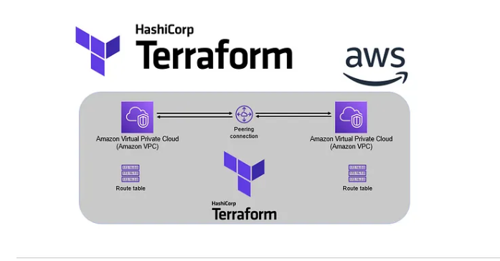
Architecture

Slide 5
Terraform Configuration Breakdown
VPC: The virtual network where our resources will reside.
Subnets: Public and private subnets to separate different types of resources.
Internet Gateway (IGW): Allows instances in the public subnet to access the internet.
NAT Gateway: Provides internet access to instances in the private subnet.
Route Tables: Direct traffic between subnets and the internet.
Security Groups: Define inbound and outbound rules for instances.

Slide 6
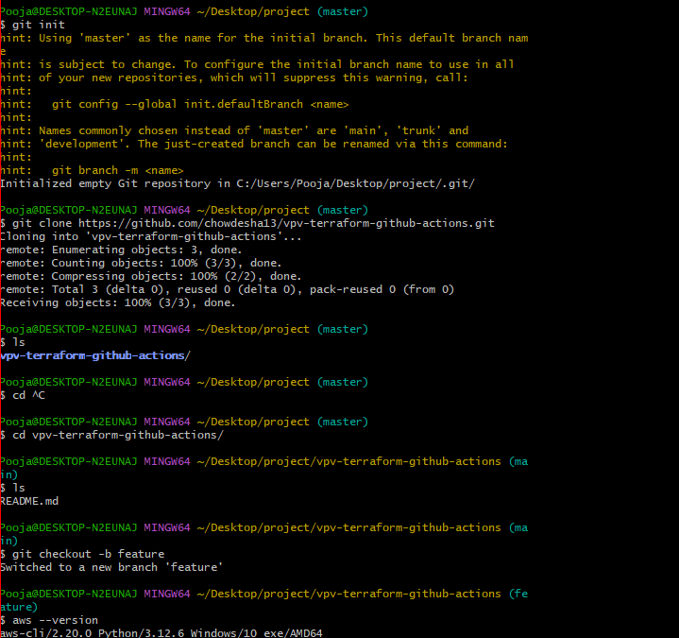
Using git hub push the code from server to local repository below is repository link: vpc-terraform-github-actions/Terraform-VPC at main · gauri17-pro/vpc-terraform-github-actions · GitHub

Slide 7
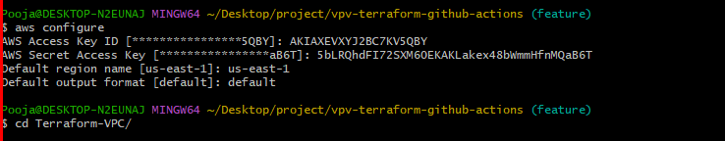
Configure the aws account using access key and secret key

Slide 8
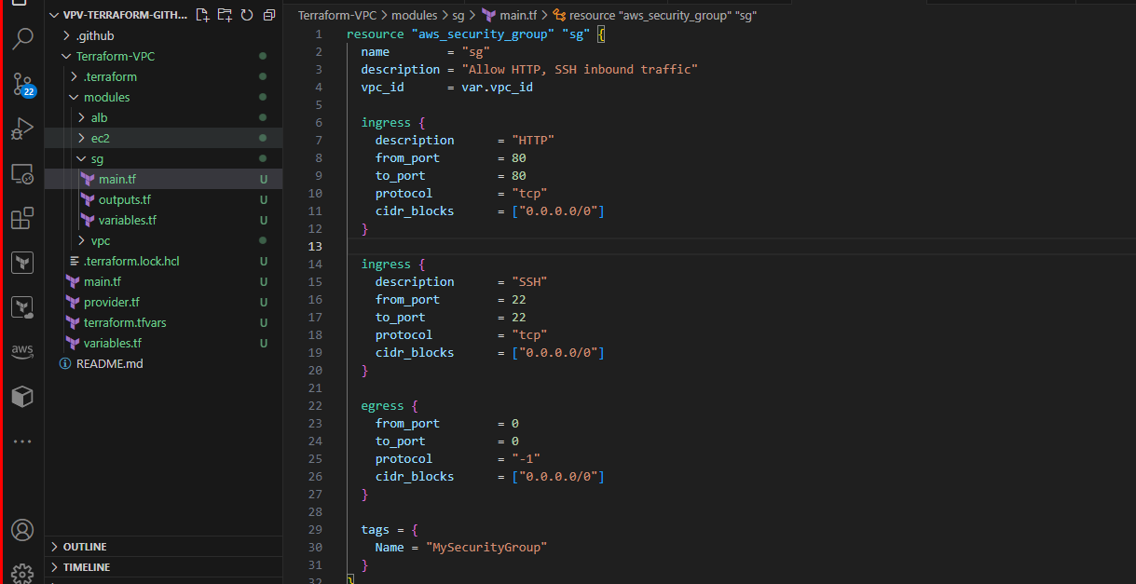
Provide the vpc details

Slide 9
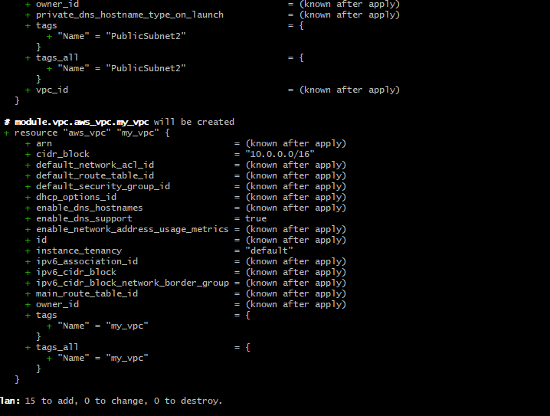
Vpc, subnets, route table, ec2 has created.

Slide 10
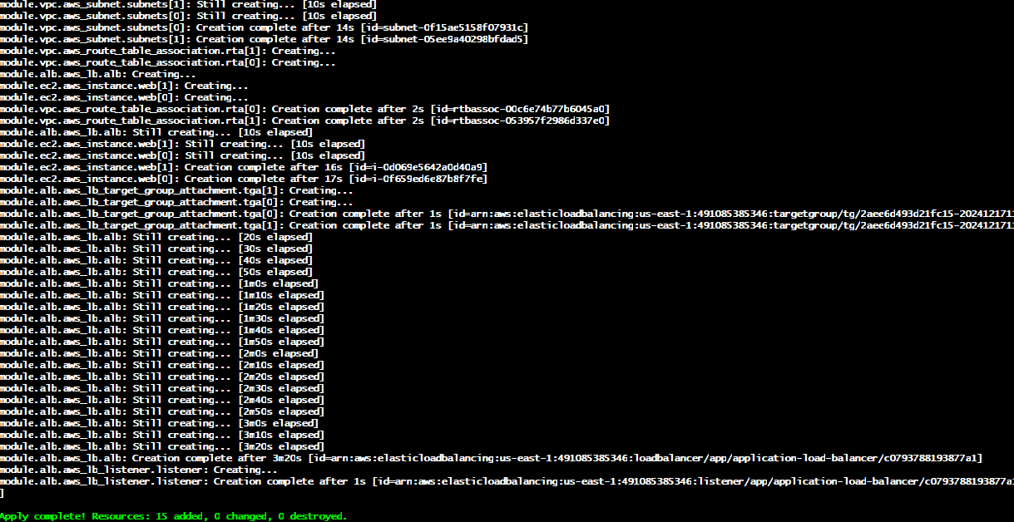
Terraform plan is succefully completed

Slide 11
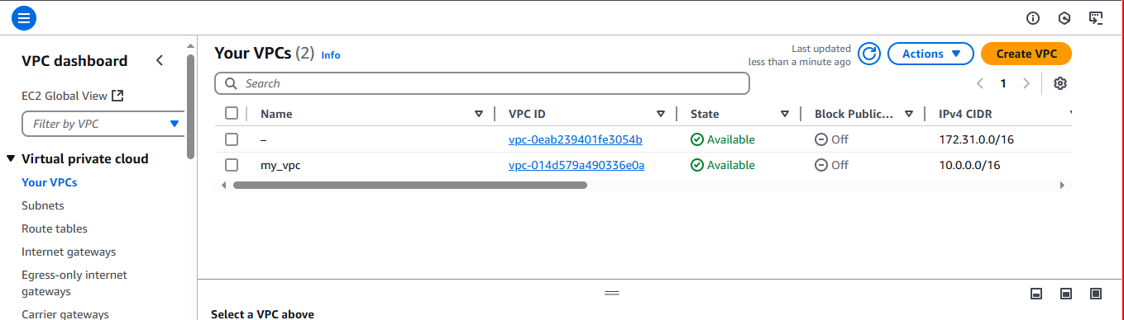
Check in aws console vpc has created

Slide 12
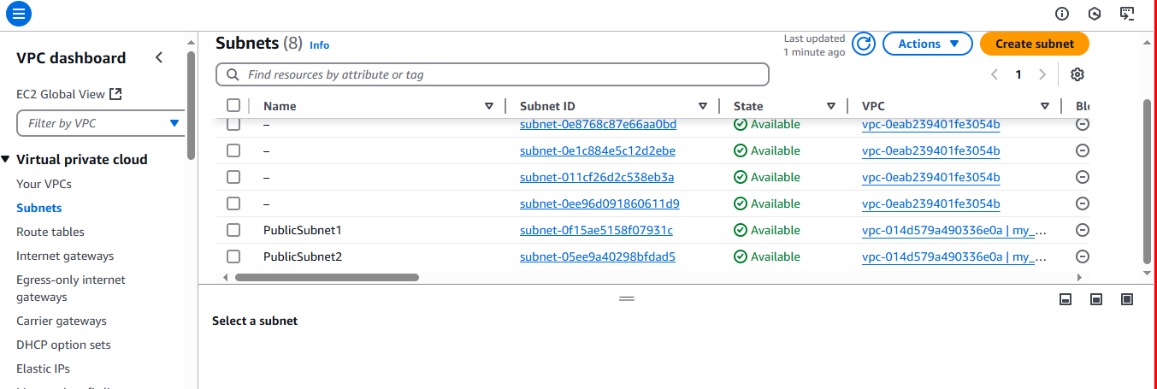
Check in aws console subnet has created

Slide 13
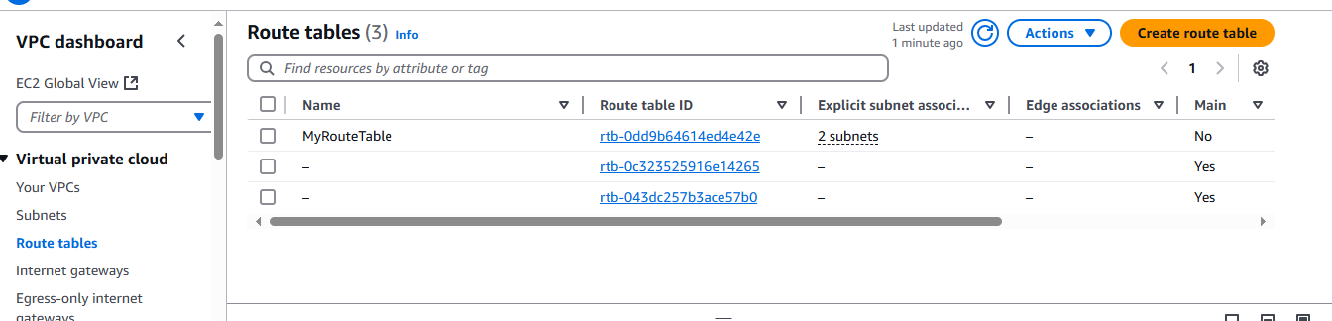
Check in aws console route table has created

Slide 14
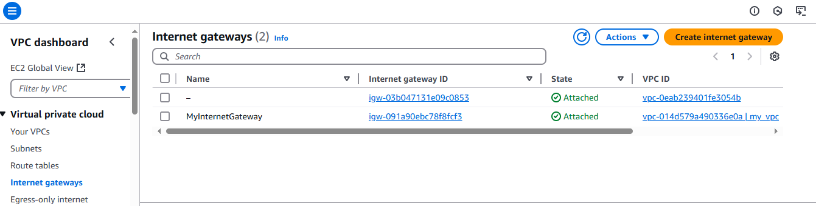
Check in aws console internet gateway has created

Slide 15
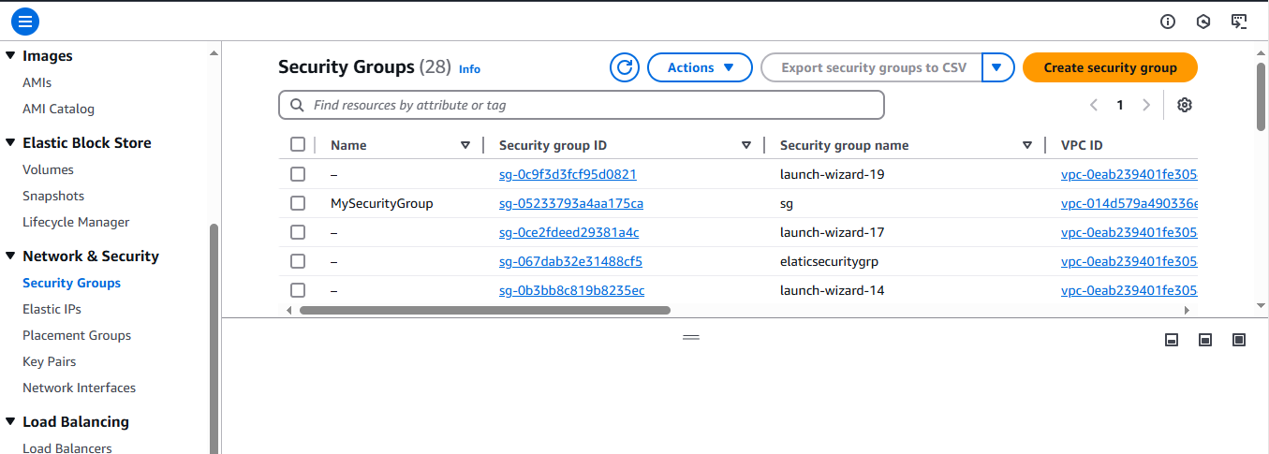
Check in aws console security groups are added

Slide 16
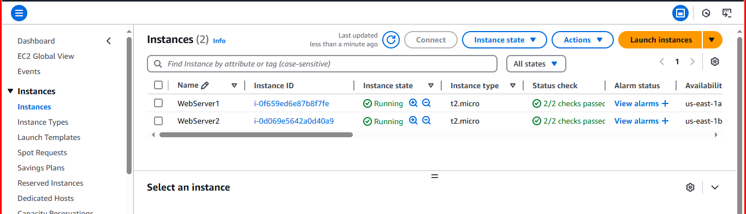
Check in aws console two instance has created

Slide 17
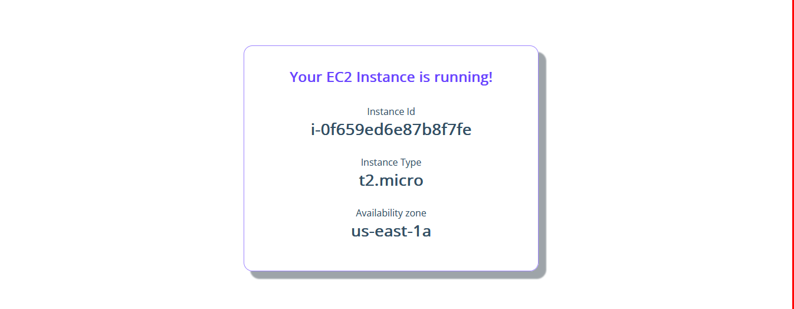
Paste the public ip address into browser and see the below result

Slide 18
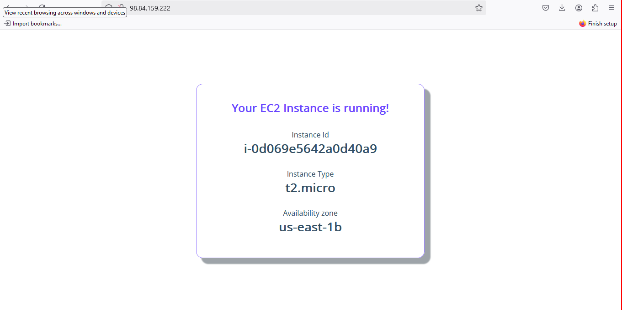
Paste the another public ip address into browser and see the below result

Slide 19
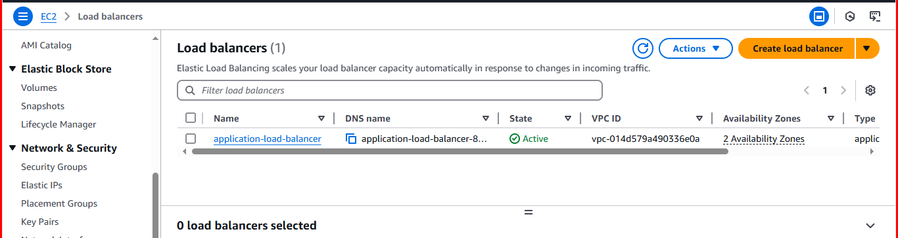
Check in aws console load balancer has created

Slide 20
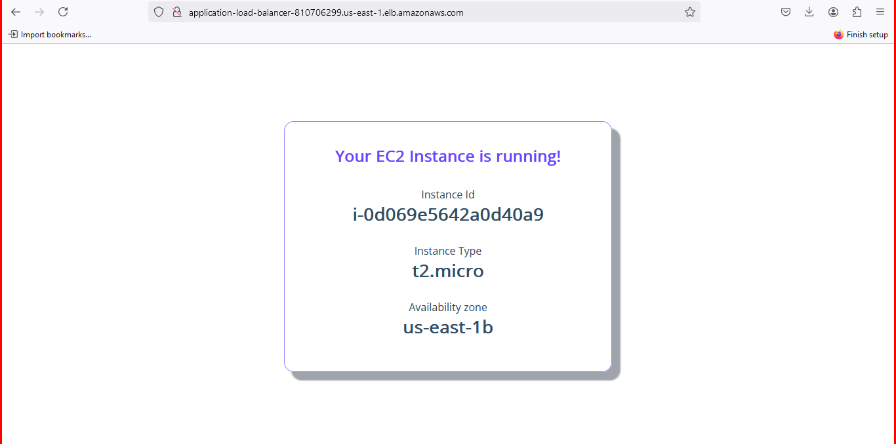
Paste the public ip address into browser and see the below result here availability zone is changed

Slide 21
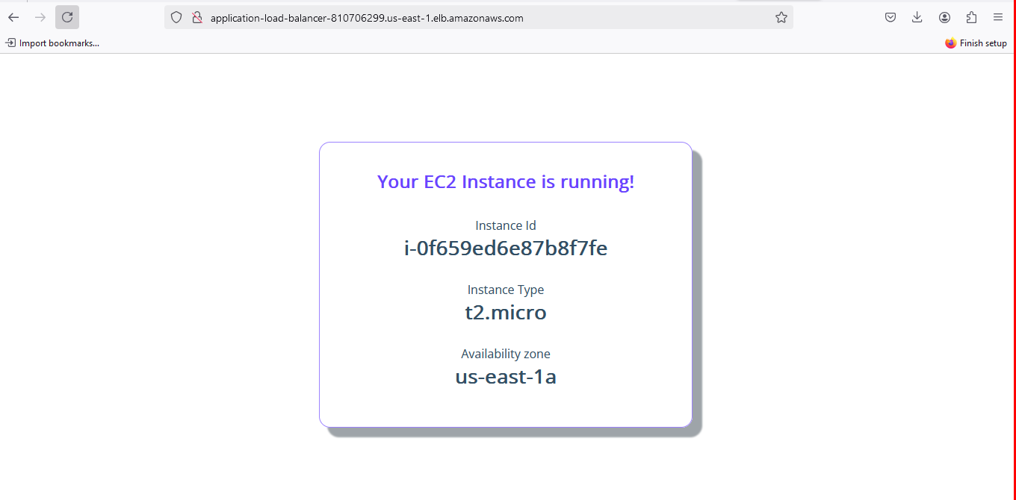
Paste the another public ip address into browser and see the below result here availability zone is changed

